Slide 1
Conserving Electricity
A Proposal to KPCL

Slide 2
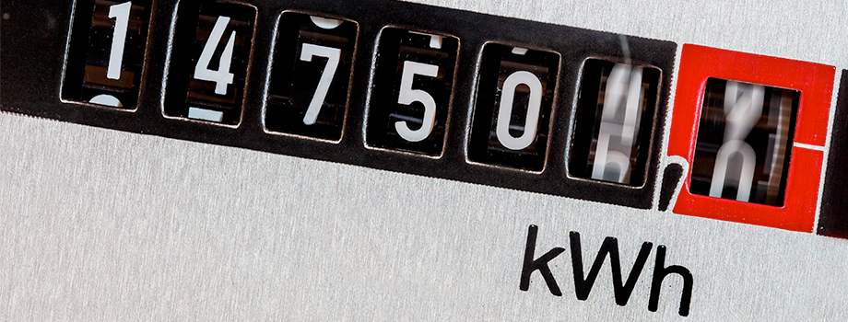
Current Scenario
Supply assuming full load usage
Actual usage < 50%
Power shortage
Buying and selling electricity

Slide 3
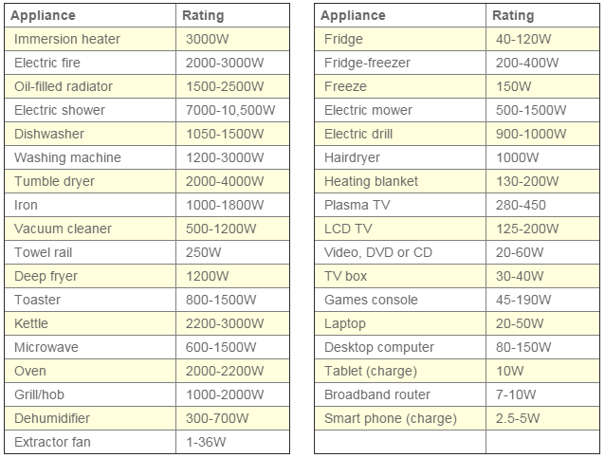
Some Numbers…

Slide 4
Who Are We?
EnergyBuzz Technologies Pvt Ltd

Slide 5

What are our Conservation Strategies?
Log electricity usage
Take into consideration
Location - Region
Season
Requirements
Modify electricity meters
This Photo by Unknown Author is licensed under CC BY-SA

Slide 6
What Data is Needed?
Structured data - fields
Electricity usage (in Watts) only when usage fluctuates
Season
Region description

Slide 7
Who will Collect the Data?
Electricity board
Procedure
Installation of auxiliary NFC enabled devices
Collect data
Use data to study patterns
Use patterns to determine actual usage
Carry out predictive analysis
Supply this amount of electricity

Slide 8
What Are The Issues Associated?
Enforcing installation of auxiliary devices to electricity meter
New connections need time for the pattern of usage to be understood
Continuous learning process

Slide 9
Thank You!

